Slide 1
The Diffusion of Innovations
Bernardo A. Huberman
Mechanisms and Design Lab
HP Labs

Slide 2
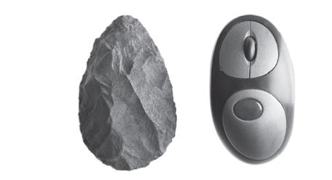
Hand made Axe, .5 million years ago, M. Ridley, “The Rational Optimist”

Slide 3
How did this happen?
Through the exchange of materials and ideas
M. Ridley, “The Rational Optimist”

Slide 4
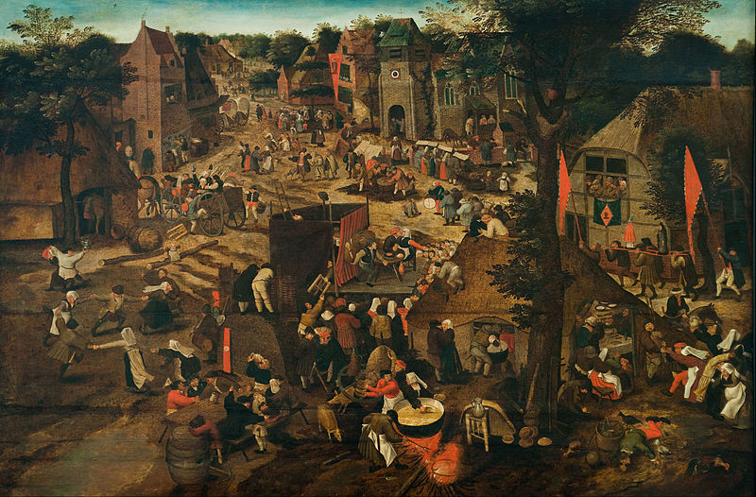
A collective intelligence at work
Bruegel, Peter the Younger. Village Fair (1564 - 1638)

Slide 5
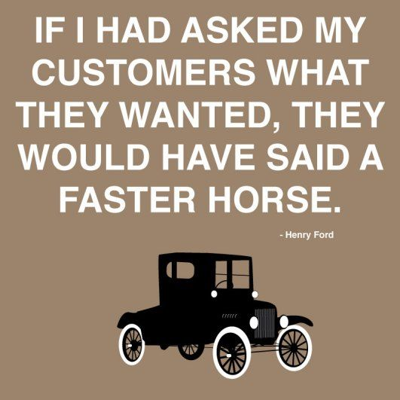
Imitation and innovation

Slide 6
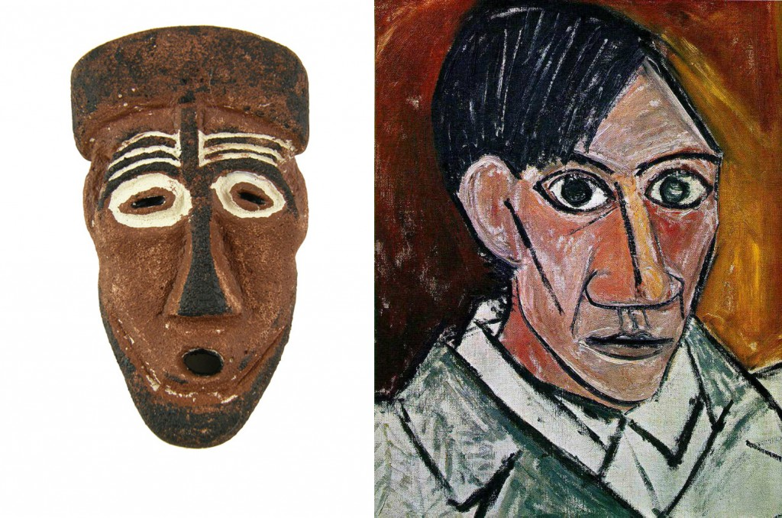
Imitation and innovation

Slide 7
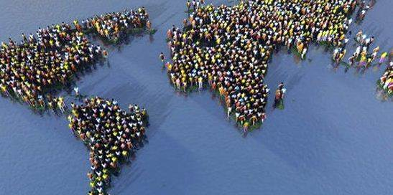
The collapse of distance
The Internet, 2000

Slide 8
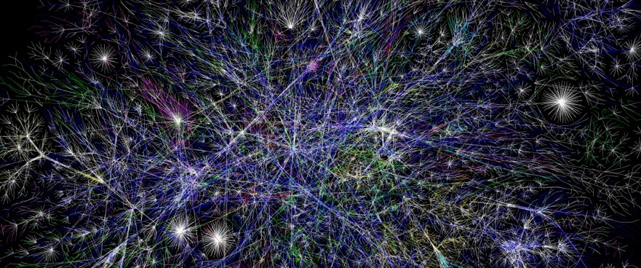
The collective brain

Slide 9
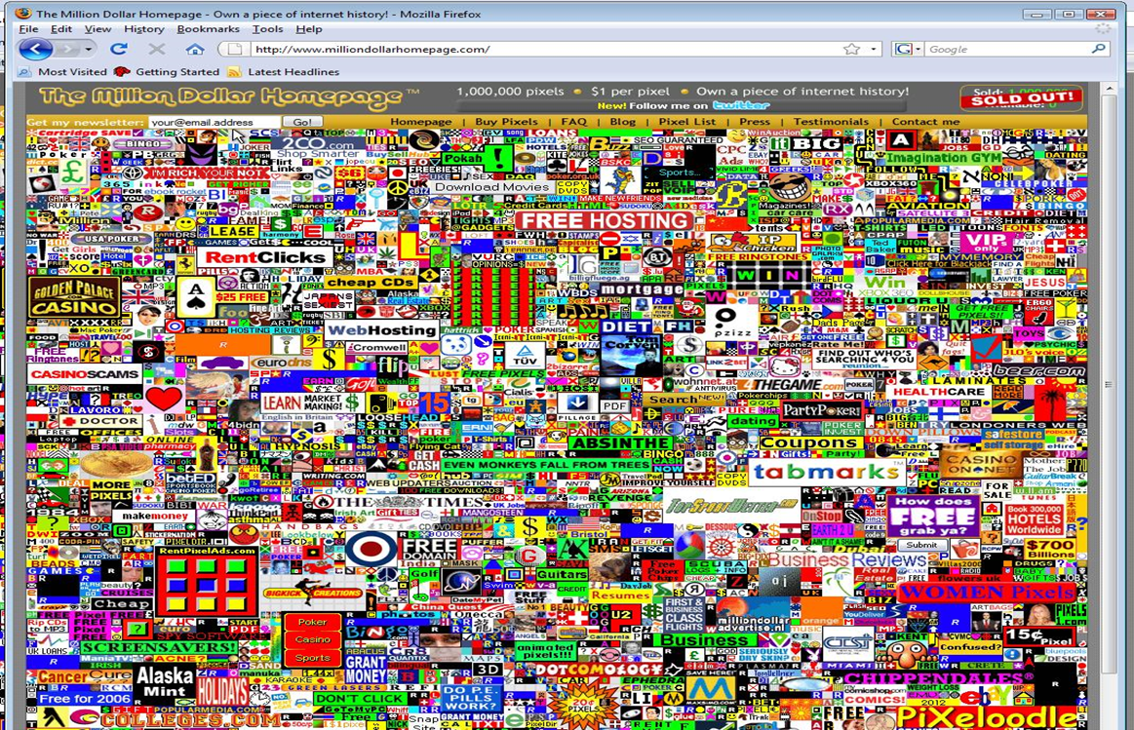
Competing for attention

Slide 10
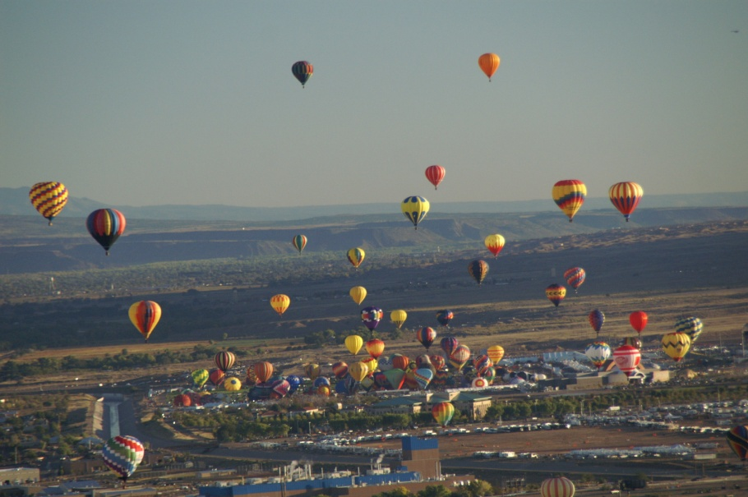
Discovering
In the attention economy we become aware of what balloons to the top.
Seldom do we notice the rest.

Slide 11

Adoption and externalities
The value of an innovation depends on how many individuals adopt it.
Telephone, email, social media, etc.
Note: the estimate of how many have adopted is not very precise

Slide 12
Diffusion
If estimates are imperfect, how long until the new technology is adopted?
It is actually two questions:
1. How long until adoption starts
2. Once adoption starts, how long
until a critical mass is formed.
The answer is both interesting and surprising.
Exponentially long (in the number of people)
Very short (logarithmic in the number of people)
H. A. Ceccatto and B. A. Huberman, Proc. Natl. Acad. Sci. USA, Vol. 86, 3443-3446 (1989)
C. H. Loch and B. A. Huberman, Management Science, Vol. 45, 160-177 (1999)

Slide 13
Dynamics: Punctuated Equilibrium

Slide 14
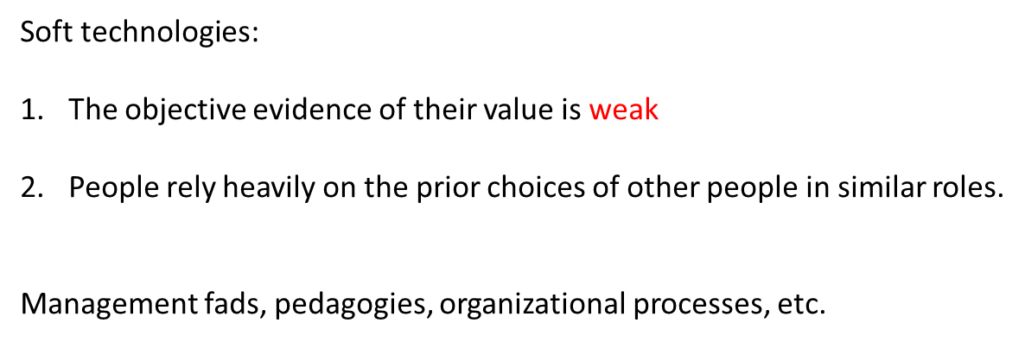
Diffusion of Soft technologies
Examples:
Quality circles: 90% of Fortune 500 companies adopted QC by 1985
80% abandoned it by 1987
Process re-engineering: same story
Education: fads are too many to be listed (new math, back to basics, multi-sensoring educations, etc, etc.)

Slide 15
Soft technologies
The adoption process is quite paradoxical:
The path of the process quickly settles down to a fixed fraction of adopters that is not predetermined by initial conditions.
Outcomes appear to be deterministic and causally explained in spite of being governed by a stochastic process
J. Bendor, B. A. Huberman and F. Wu, Journal of Economic Behavior and Organizations, Vol. 72, 290-304 (2009)

Slide 16
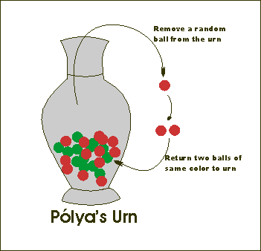
A simple model of imitation
What is the final (if any) fraction of colors in the urn?

Slide 17
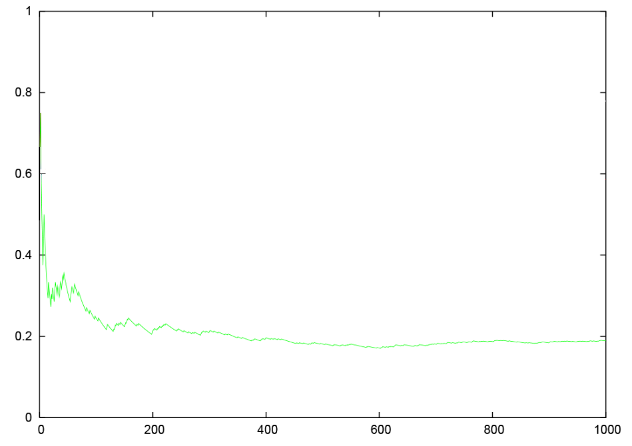
Dynamics
fractions
time

Slide 18

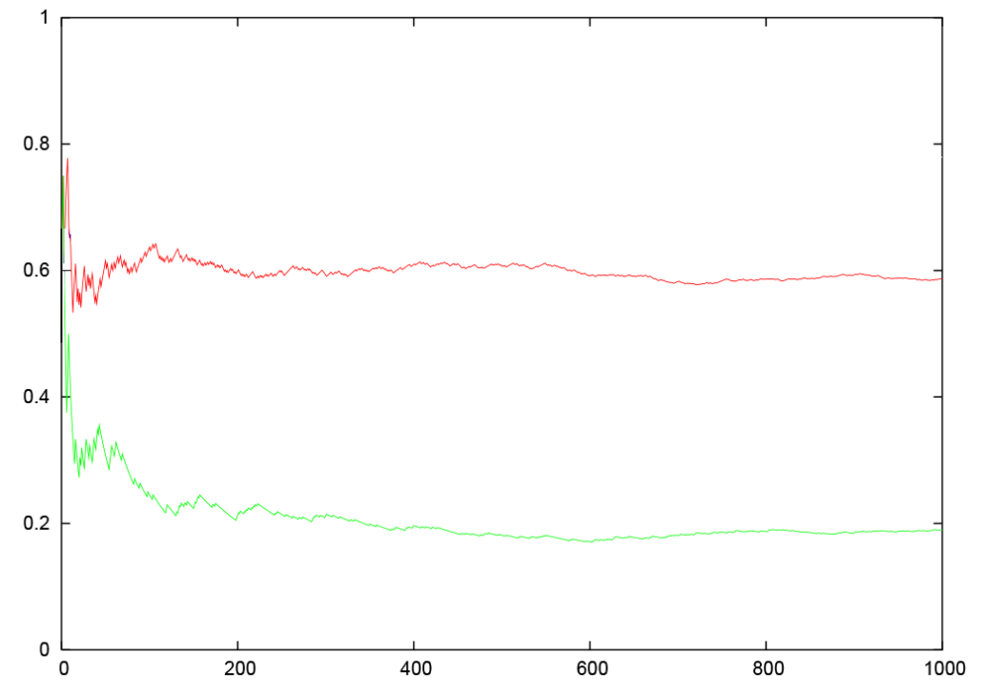

fractions

Slide 19
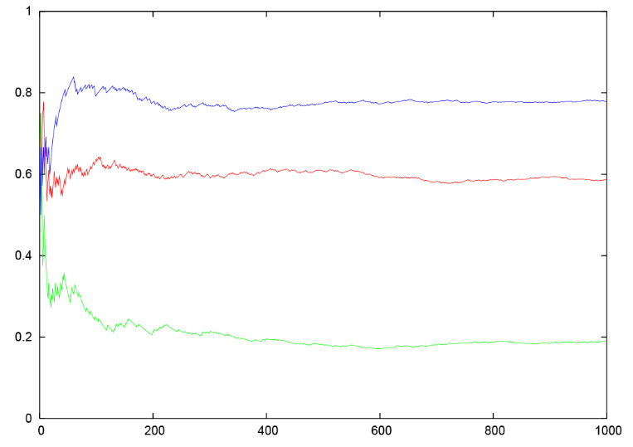
Dynamics
fractions
time

Slide 20
Why should we care?
Dynamics appear to be deterministic in spite of being stochastic.
In plain English, one cannot read much into that “history”.
If evidence is weak, the evolution of the process settles down to a fraction of adopters that is not predetermined.
When evidence is strong, the proportion of adopters is determined by the quality of the evidence.

Slide 21
Internet Economics
Decreasing costs in communication cost of transmitting information essentially zero.
Competitive equilibrium theory inapplicable because in the internet the price of a web page is zero, and supply will always match demand.
Only variable to consider is aggregate demand: visitors, downloads, etc.

Slide 22
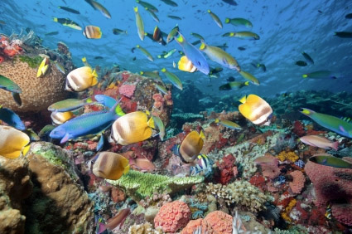
Co-existence and competition
Search Engines:
Web Crawler,
Lycos
Alta Vista
Excite
Yahoo
Dogpile
Ask Jeeves
Google
HotBot
AlltheWeb

Slide 23
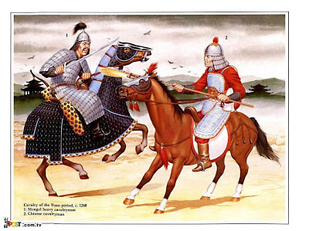
Competitive dynamics
2 firms

Slide 24
Dynamics
Fraction of adopters of website 1 as a function of competitive parameter
S. Maurer and B. A. Huberman, Journal of Economic Dynamics and Control, Vol. 27, 2195-2206, (2003)

Slide 25
Competitive equilibrium
Low competition level
Search Engines:
Web Crawler,
Lycos
Alta Vista
Excite
Yahoo
Dogpile
Ask Jeeves
Google
HotBot
AlltheWeb

Slide 26
Winner take all phenomenon
high competition level
Google

Slide 27
So, how do innovations happen?
By social exchanges, and in punctuated fashion.
Very often, there is no clear objective evidence of their value.
And yet their adoption appears inevitable when in reality it is the result of a random process.
In the digital economy, we encounter an enhanced version of the winner take all phenomenon.

Slide 28
GRACIAS!

